Slide 1

Credit CARD FRAUD DETECTION USING DEEP LEARNING & Machine Learning

Slide 2



Credit Card Fraud Detection: Machine Learning & Deep Learning Solutions
The global fraud detection market will reach $32.39B by 2026. Fraud prevention technologies are growing annually by 36%. Machine Learning and Deep Learning are revolutionizing financial security.
Notes:
1

Slide 3




The Growing Challenge of Credit Card Fraud
In 2023, $32.4B was lost globally to payment card fraud. Digital payment fraud has increased by 65% since 2020. Traditional detection methods are becoming obsolete. Advanced detection techniques are needed.
Massive Losses
Evolving Tactics
Billions lost annually
Fraudsters adapt quickly
Obsolete Methods
Traditional systems fail
Notes:
2

Slide 4




Machine Learning: First Line of Defense
Supervised learning algorithms are used for pattern recognition. Random Forest and Support Vector Machines are most effective. Achieve 94% accuracy in identifying potential fraud. Provide real-time transaction risk scoring.
Pattern Recognition
Real-time Scoring
Adaptive Learning
Notes:
3

Slide 5
Deep Learning Techniques
Neural networks analyze complex transaction patterns. Convolutional and recurrent neural networks are used. They reach 98.5% fraud detection accuracy. Autoencoder models help in anomaly detection.
Neural Networks
High Accuracy
Analyzing complex patterns to identify subtle indicators of fraudulent activity that traditional methods might miss.
Detecting fraud effectively by reducing false positives and improving the precision of fraud alerts.
Notes:
4

Slide 6





Key Features in Fraud Detection
Amount
Focus on transaction amount and frequency.
Location
Focus on geographic location of purchases.
Time
Consider time of transaction.
Device and Network
Check device and network information.
Spending Patterns
Analyze historical spending patterns.
Notes:
5

Slide 7
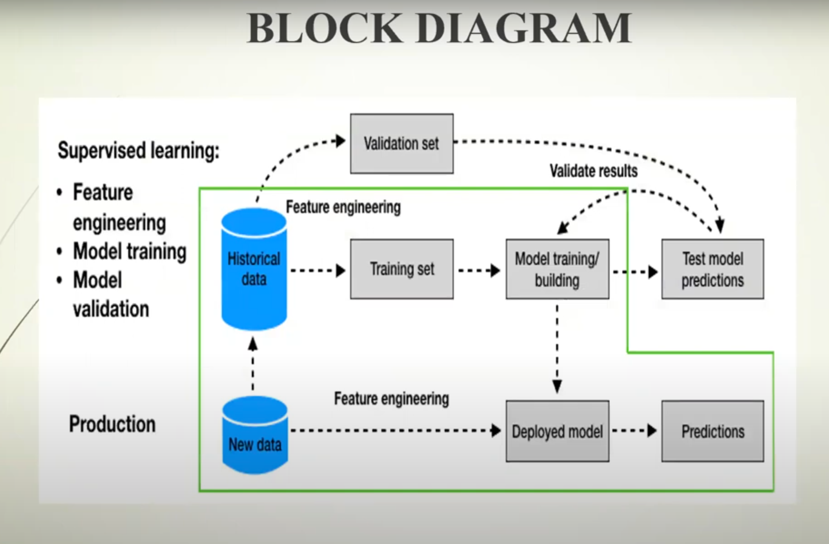
Notes:
5

Slide 8




Technical Architecture
Use a multi-layer neural network design. Apply ensemble learning approaches. Enable real-time processing infrastructure. This creates scalable and adaptable fraud detection systems.
Multi-Layer Design
Ensemble Learning
Real-Time Processing
Notes:
6

Slide 9

Challenges and Ethical Considerations
Balance fraud detection with customer experience. Address privacy concerns in data collection. Minimize false positive rates. Ensure continuous model retraining.
Customer Experience
Data Privacy
Avoiding disruption
Protecting information
False Positives
Reducing errors
Notes:
7

Slide 10



Future of Fraud Detection
Integrate AI and blockchain technologies. Implement predictive fraud prevention. Provide personalized risk assessment. Ensure continuous learning and adaptation. Aim for zero financial loss.
Predictive Prevention
Personalization
Notes:
8

Slide 11

Thank You

